Slide 1
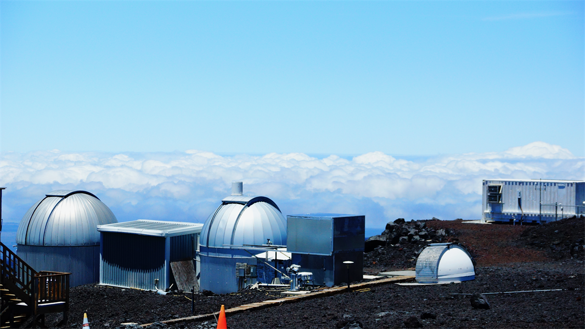
Temperature and Atmospheric CO2
Penny Rowe, Anoushka Adhav, Emma Sevier, Steven Neshyba
Source: NOAA Research

Slide 2
How are temperature and CO₂ correlated?
Ice core record: Natural climate change
Modern times: Anthropogenic climate change
This talk:
What links temperature and CO₂?
Climate change
Sources of temperature and CO2 records
Image source: Lucian Dachman, Unsplash

Slide 3
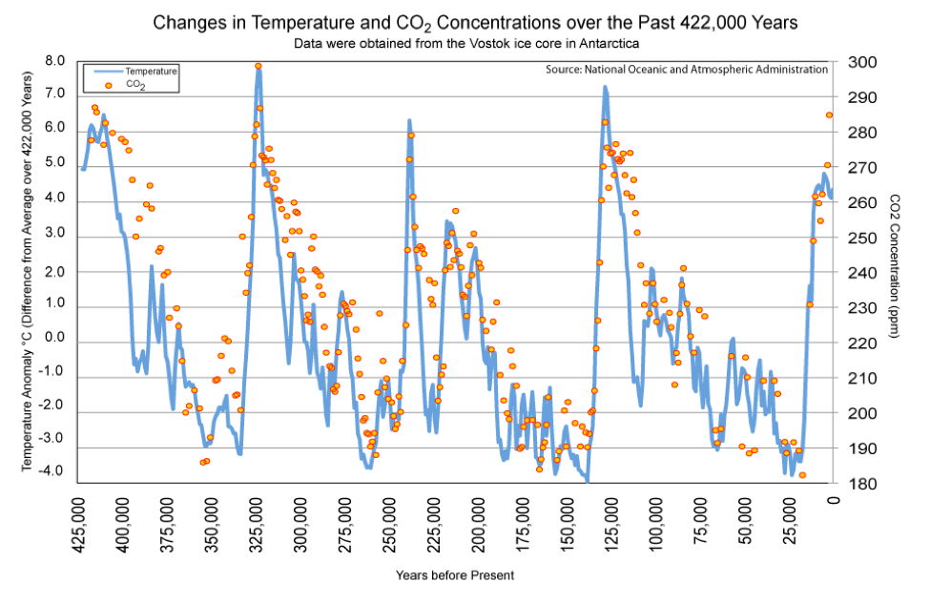
Image source: Lucian Dachman, Unsplash

Slide 4
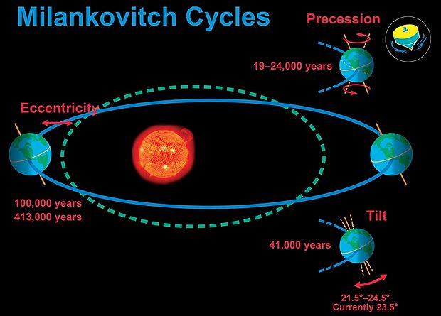
Natural Climate change is driven by orbital cycles
Orbital cycles change how much sunlight reaches the earth, hence can drive glaciation/deglaciation cycles.
The catch: Orbital-related changes in solar energy aren’t big enough on their own. They needed some kind of climate amplifier (like CO₂)
CO₂ amplifies warming & cooling:
Warming oceans release CO₂
When seas are warmer, phytoplankton uptake less CO₂
Courtesy UCAR

Slide 5
Image source: Lucian Dachman, Unsplash

Slide 6
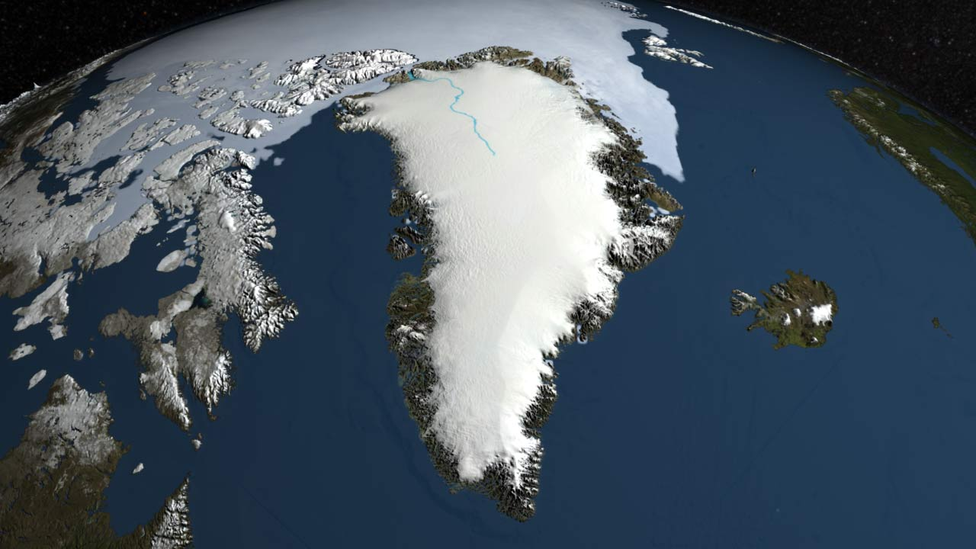
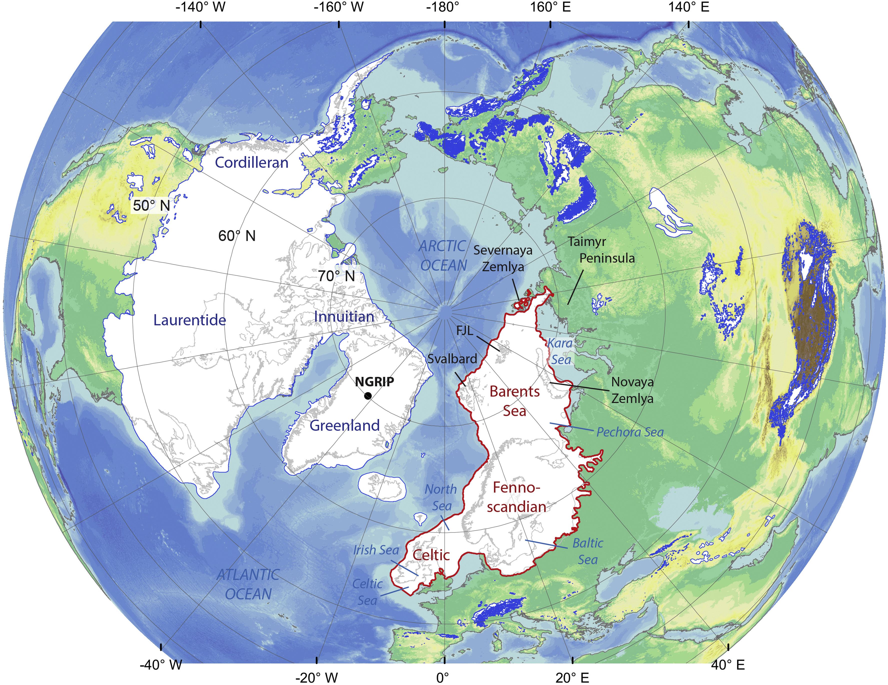
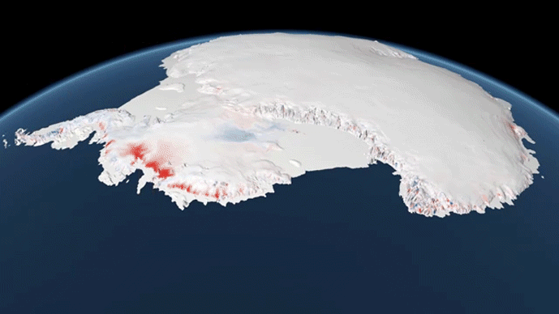
The “Last Glacial Maximum” Great ice sheets of 20,000 years ago
Greenland
North American and Eurasian ice sheets
Courtesy NASA visualization
Antarctica
Courtesy Henry Patton
Courtesy Philip Eales, Planetary Visions
Notes:
Patton, H., Hubbard, A., Andreassen, K., Winsborrow, M., Stroeven, A.P., 2016. The build-up, configuration, and dynamical sensitivity of the Eurasian ice-sheet complex to Late Weichselian climatic and oceanic forcing. Quaternary Science Reviews 153, 97–121.https://doi.org/10.1016/j.quascirev.2016.10.009

Slide 7
Lots of melting in the last 20,000 years
Greenland
North American and Eurasian ice sheets
Courtesy NASA
Courtesy NASA visualization
Antarctica
Courtesy NASA
Courtesy Henry Patton
Courtesy Philip Eales, Planetary Visions

Slide 8
Image source: Lucian Dachman, Unsplash

Slide 9
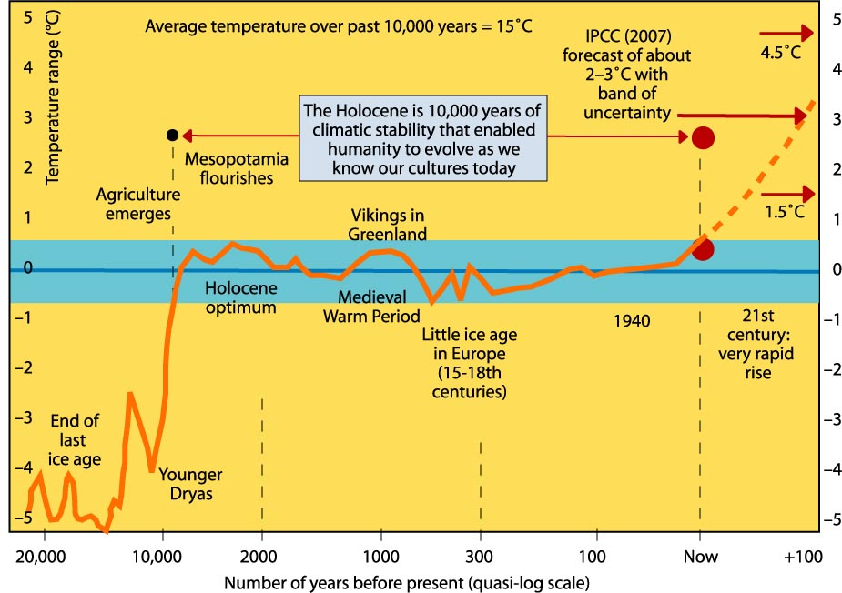
Climate has remained pretty steady in the last 10,000 years
Image courtesy Robert Corell
Notes:
http://www.climatecodered.org/2011/01/rethinking-safe-climate-have-we-already.html

Slide 10
Climate has remained pretty steady in the last 10,000 years Until human-caused Climate Change began
Image courtesy Robert Corell
Notes:
http://www.climatecodered.org/2011/01/rethinking-safe-climate-have-we-already.html

Slide 11
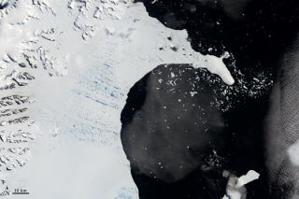
Disintegration of Larsen B in 2002
January 31, 2002
March 5, 2002
Courtesy NASA
Courtesy NASA

Slide 12
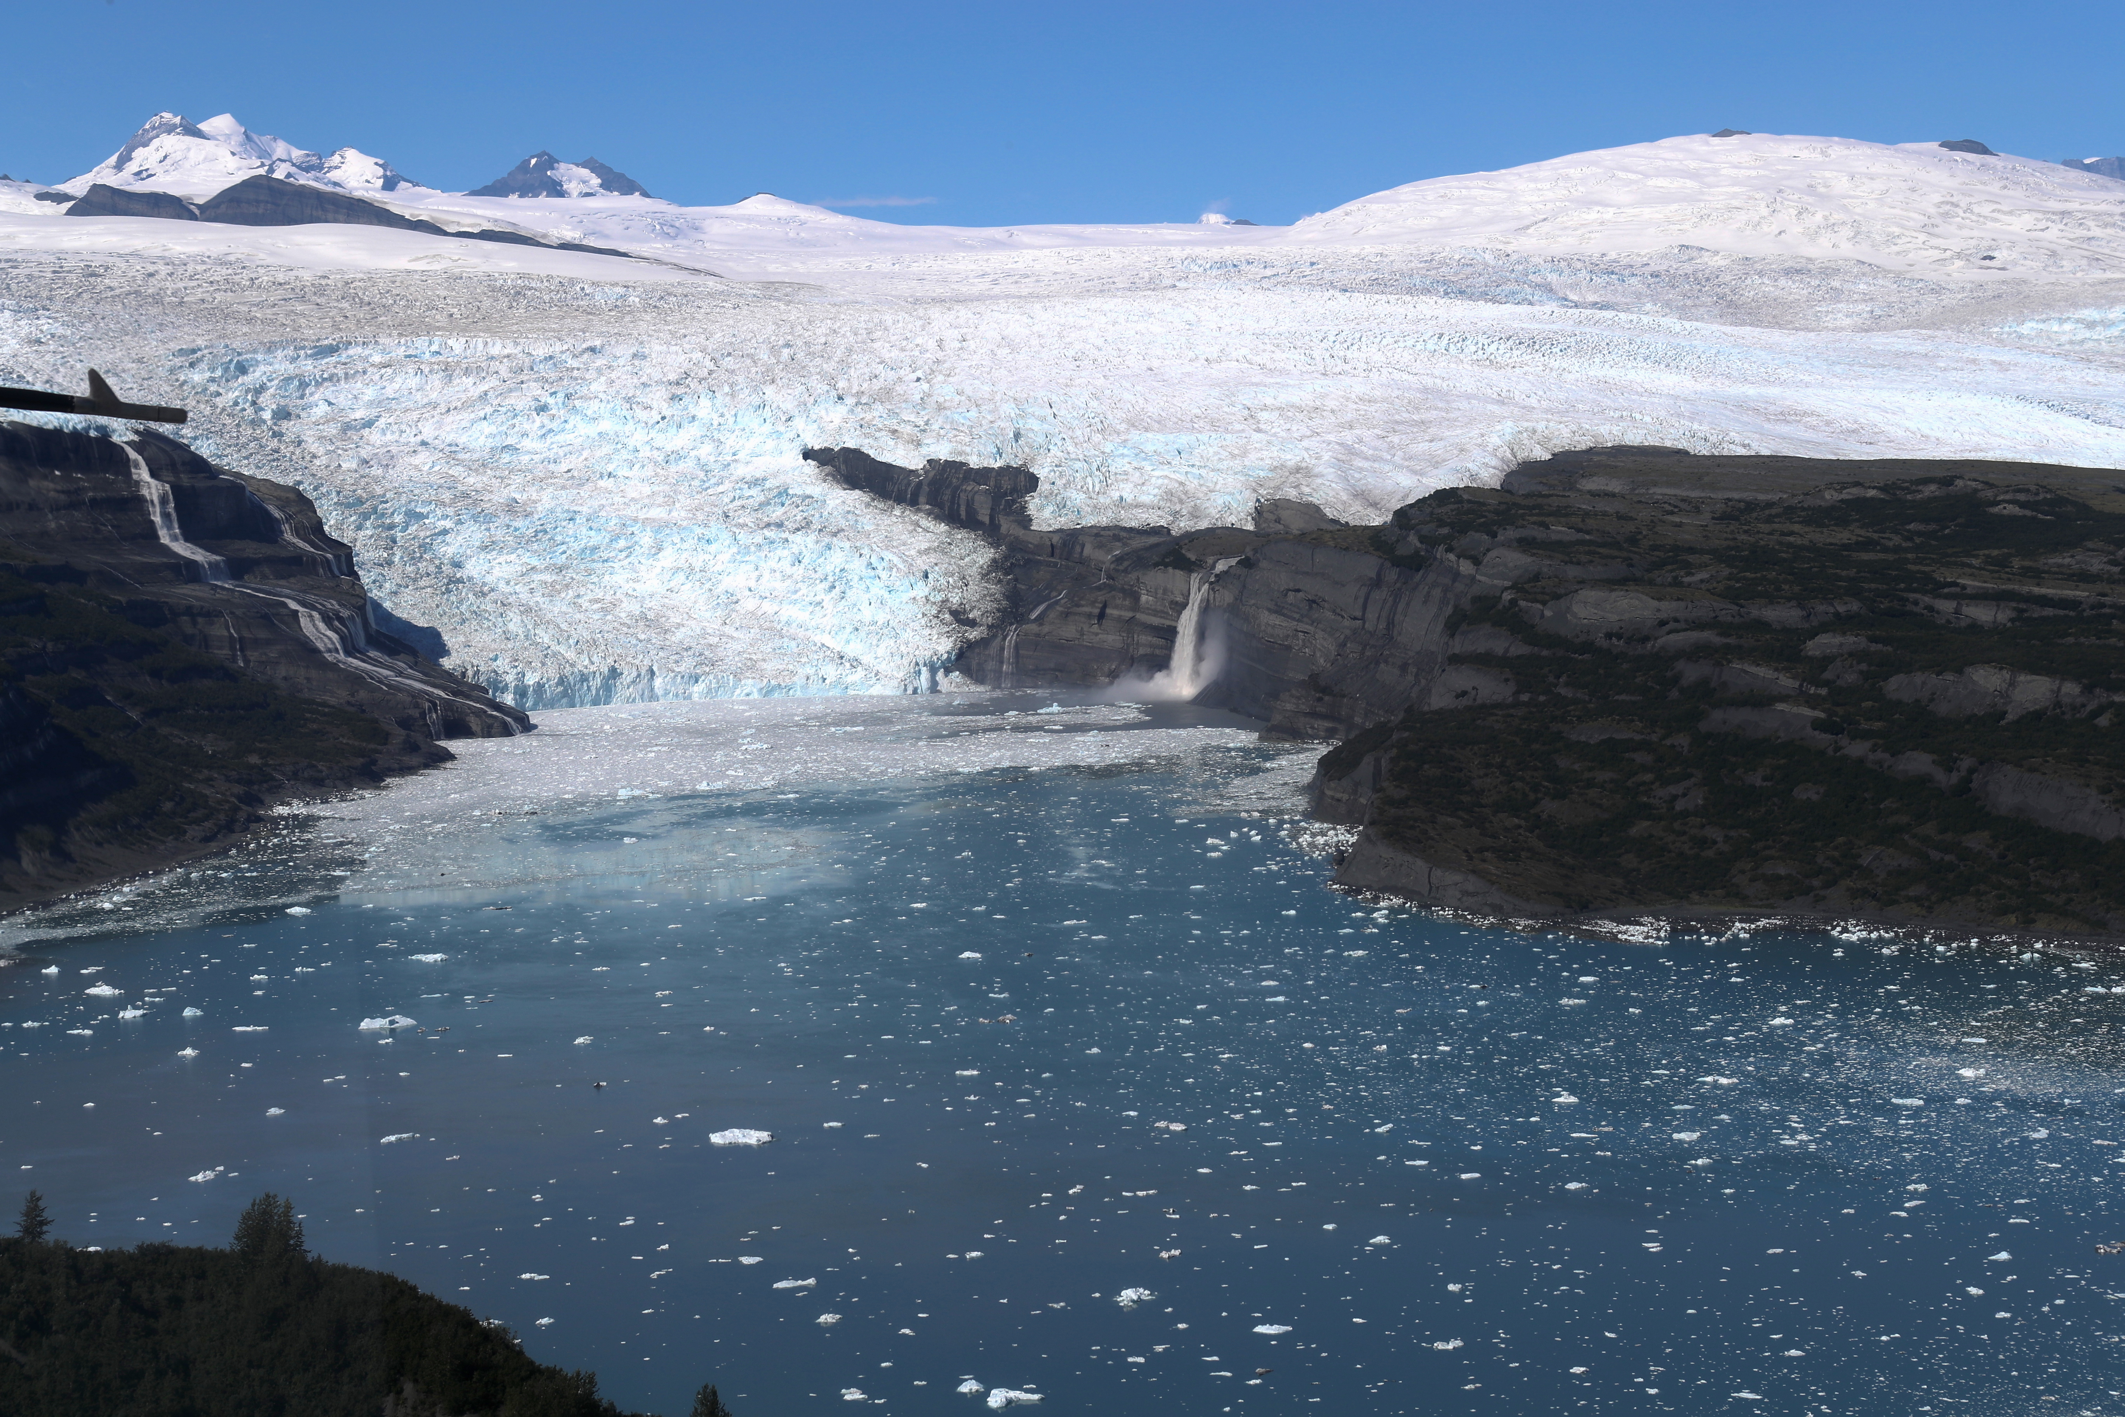
What are the prospects for future sea level rise?
Antarctica: 58 meters sea level equivalent (SLE)
Greenland: 7.4 m
53.3 meters
4.5
Courtesy NASA
Courtesy NASA
SLE estimates from Davies, 2019
Mountain glaciers:
0.4 m (40 cm)
Courtesy NASA

Slide 13
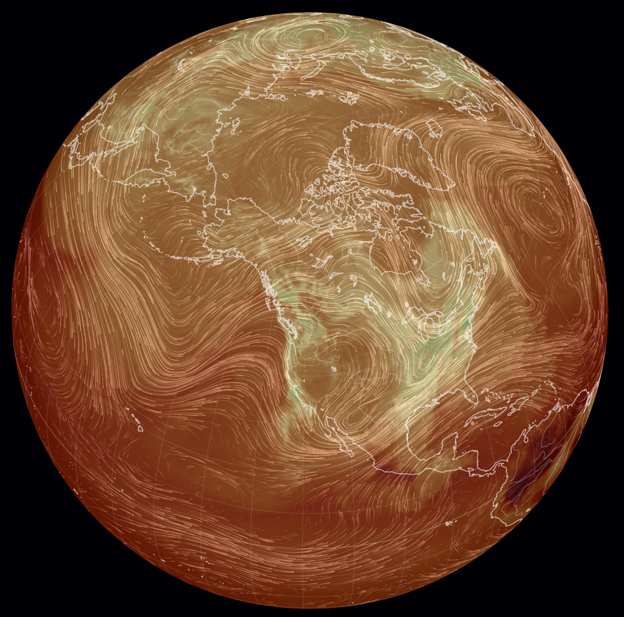
Part I: Polar temperature and CO₂ in modern times
Utqiagvik, Alaska
How are CO2 and temperature correlated since humans started changing climate?
We will compare CO₂ measurements made at Mauna Loa, Hawaii, to temperature measured at Utqiagvik, Alaska
Mauna Loa, Hawaii
Carbon Dioxide Surface Concentration: earth.nullschool.net 2020/12/4 09:31 PT
Image source: Lucian Dachman, Unsplash

Slide 14
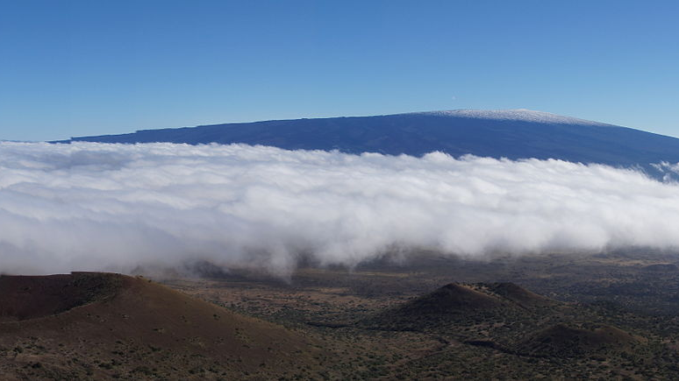
Mauna Loa Atmospheric CO2 Observatory
Located on Mauna Loa Volcano, Hawai’i, 11,135 ft. above sea level
Collecting atmospheric data since 1950’s
Undisturbed air, remote location, minimal vegetation & human presence = > ideal location
Source: Madereugeneandrew, view of Mauna Loa taken from Pu’u

Slide 15
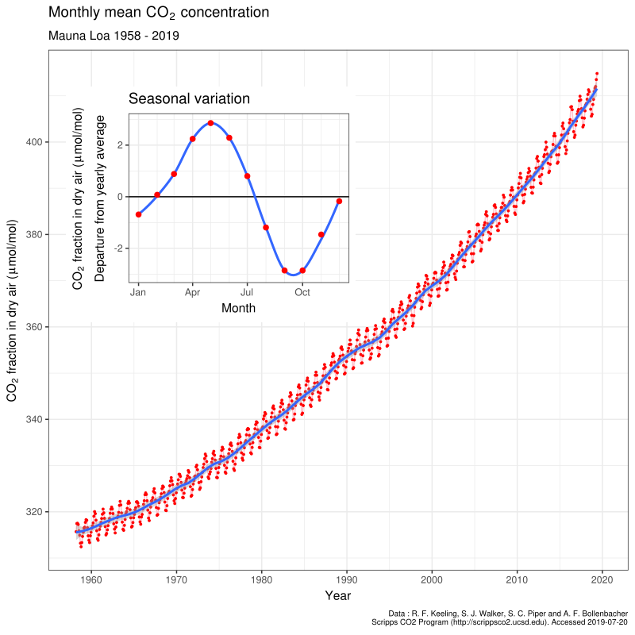
The Keeling Curve
Atmospheric CO₂ (ppm)
Daily record of CO2 in Earth’s atmosphere based on continuous measurements from Mauna Loa
Maintained by the Scripps Institute of Oceanography
Source: Delorme, data from Dr. Pieter Tans, NOAA/ESRL & Dr. Ralph Keeling, Scripps Institute of Oceanography
1960 1970 1980 1990 2000 2010 2020

Slide 16
The Keeling Curve
Atmospheric CO₂ (ppm)
ppm => parts per million
410 ppm => If I grab a million molecules from the air, 410 will be CO2
Daily record of CO2 in Earth’s atmosphere based on continuous measurements from Mauna Loa
Maintained by the Scripps Institute of Oceanography
Source: Delorme, data from Dr. Pieter Tans, NOAA/ESRL & Dr. Ralph Keeling, Scripps Institute of Oceanography
1960 1970 1980 1990 2000 2010 2020

Slide 17
The Keeling Curve
CO₂ (ppm)
Daily record of CO2 in Earth’s atmosphere based on continuous measurements from Mauna Loa
Maintained by the Scripps Institute of Oceanography
Source: Delorme, data from Dr. Pieter Tans, NOAA/ESRL & Dr. Ralph Keeling, Scripps Institute of Oceanography
1960 1970 1980 1990 2000 2010 2020

Slide 18
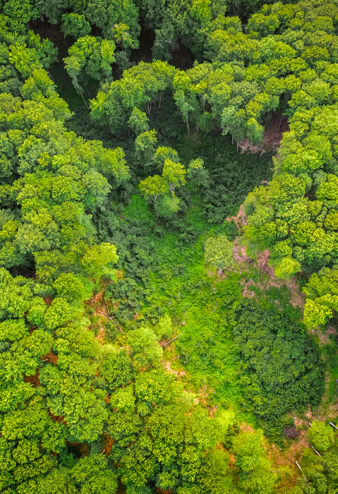
What Causes Seasonal Variation in the Keeling Curve?
Annual variation of ~5ppm
Most vegetation is in the Northern Hemisphere
Decreases during northern spring and summer as new plant growth takes CO2 out of the atmosphere through photosynthesis.
Increases during northern fall and winter as plants and leaves die off and decay, releasing CO2 back into the atmosphere.
Image source: Lucian Dachman, Unsplash

Slide 19
CO₂ is well-mixed in the atmosphere
Utqiagvik, Alaska
We will compare CO₂ measurements made at Mauna Loa, Hawaii, to temperature measured at Utqiagvik, Alaska
Mauna Loa, Hawaii
Carbon Dioxide Surface Concentration, from earth.nullschool.net on Dec. 4, 2020, 09:31 PT.
Image source: Lucian Dachman, Unsplash

Slide 20
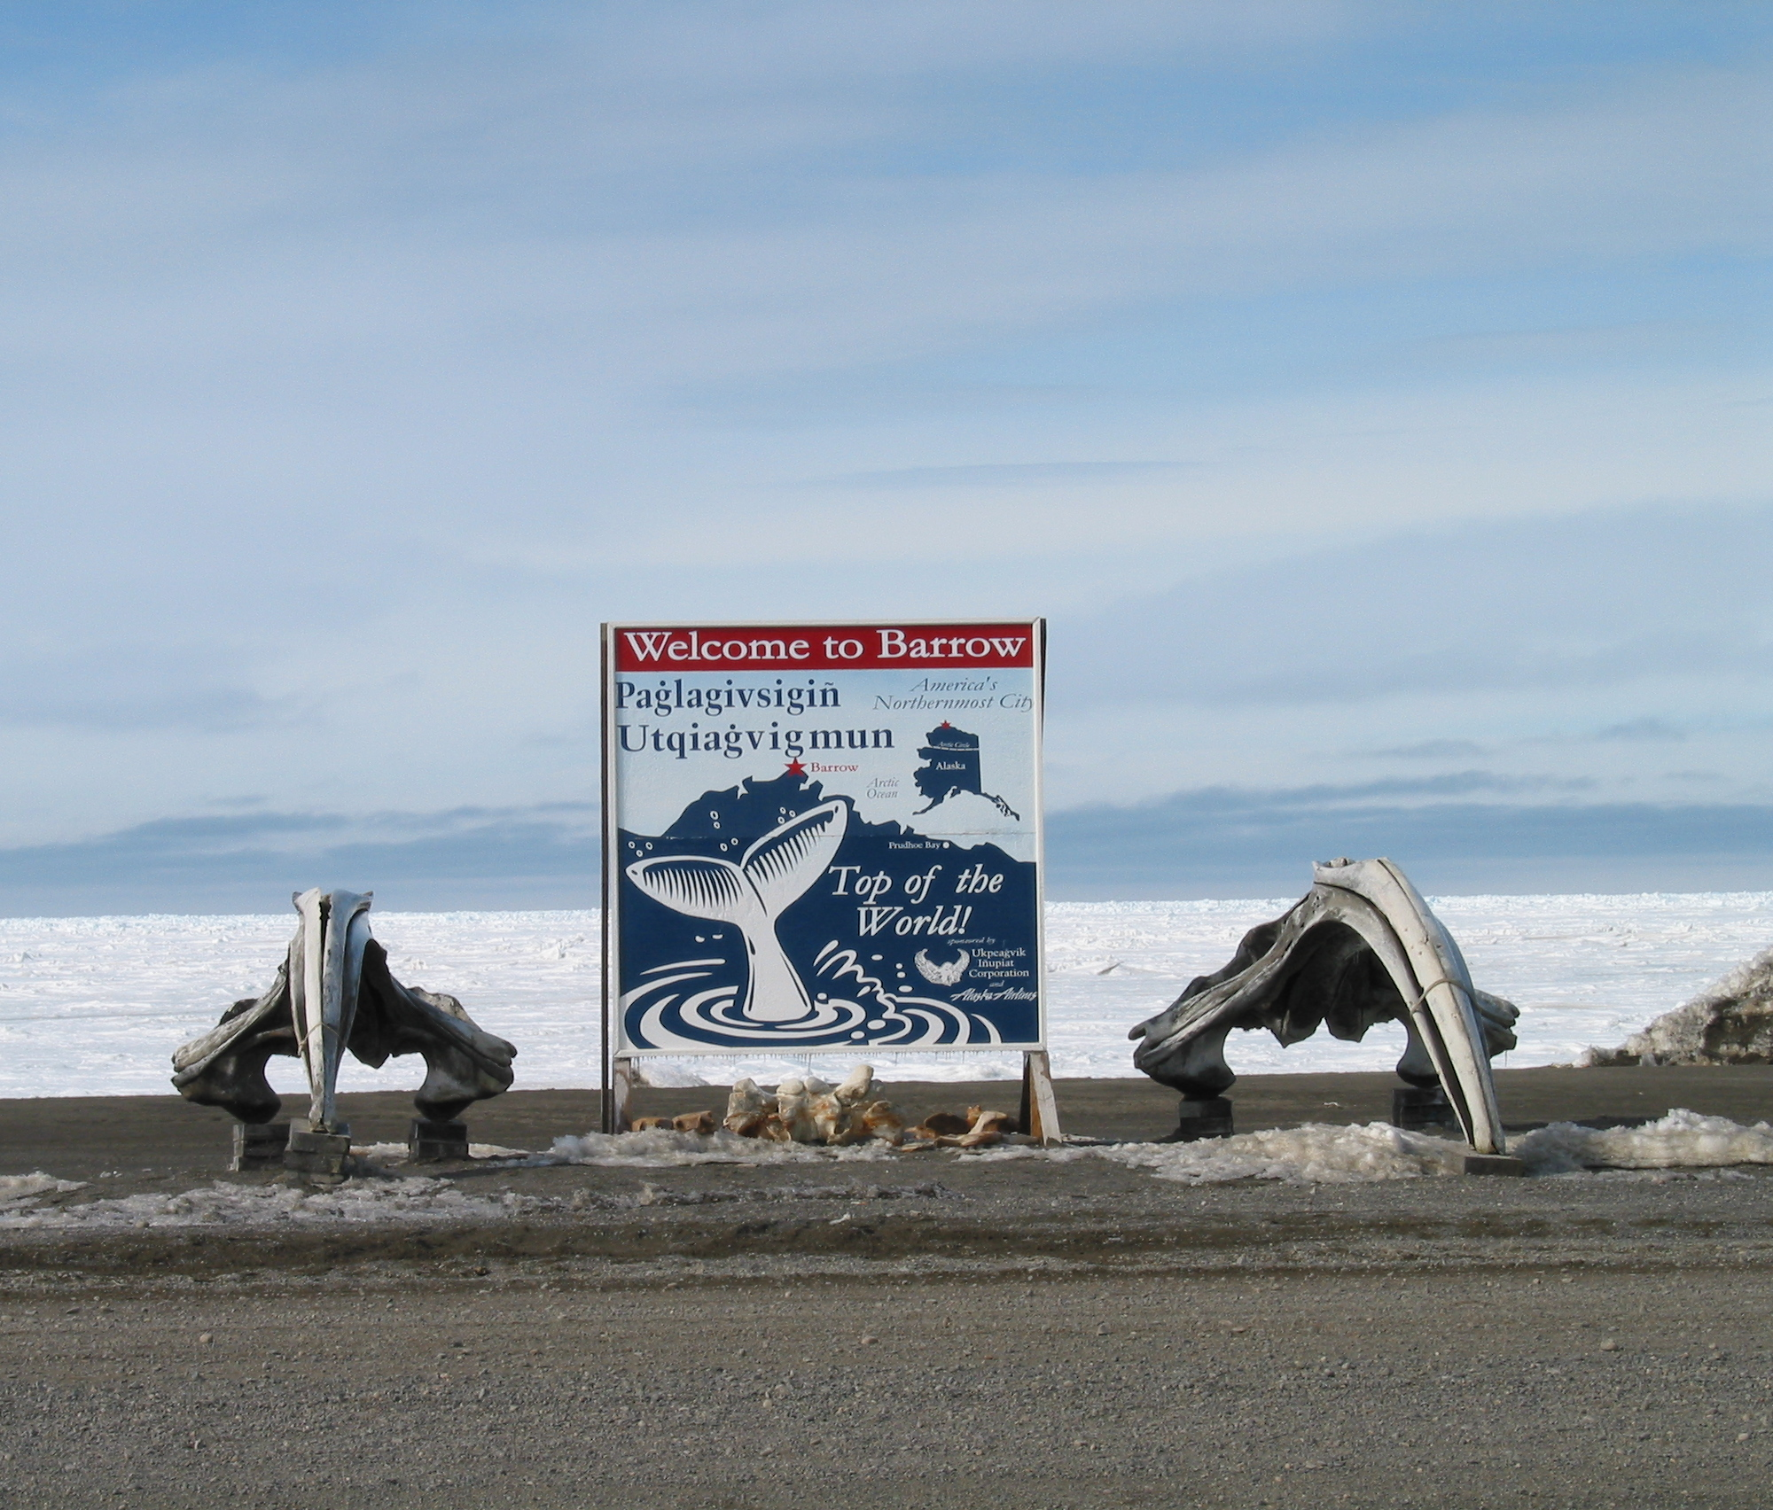
Why Utqiagvik?
Polar Temperature Data from Utqiagvik, Alaska
Located in the Arctic Circle (polar)
Polar regions are warming faster than other parts of the globe: Polar Amplification
Faster warming means faster temperature rise
Long term temperature measurements (at Pt. Barrow)
Source: unknown author, Wikimedia

Slide 21
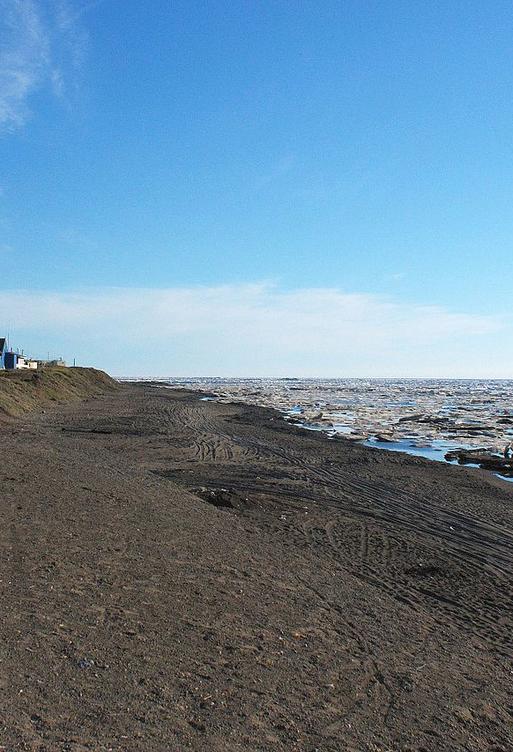
Utqiagvik
Home to the Inupiat (an indigenous Inuit ethnic group) for more than 1,500 years
Cold and dry climate
Below freezing Oct.-May
Warmest month of year: July, average temperature of 4.9 degrees Celsius
Predominantly tundra over permafrost, or frozen ground
Experiencing polar amplification of climate change
Source: Andrei Taranchenko, Flickr

Slide 22
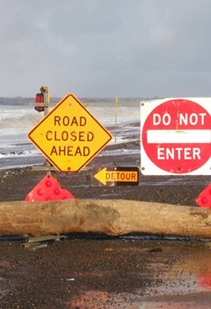
Climate Change in Utqiagvik
Polar amplification
Exacerbated by positive feedback cycles
Loss of sea ice exposes darker ocean, which absorbs more sunlight, leading to warming and further ice loss
Open ocean leads to other changes (evaporation/clouds, heat exchange, etc)
Permafrost (frozen ground) is thawing, damaging infrastructure.
Implications for residents of Utqiagvik
Source: Dave Anderson, climate.gov
Notes:
Loss of autumn sea ice coverage since 2002 => more open water to the west and northwest of Utqiagvik which leads to exceptionally warm Octobers

Slide 23
Utqiagvik Temperature Record Data
Data recorded by NOAA Climate Monitoring Lab
Data from 1901-2020
Weather station located at Utqiagvik Airport
Data retrieved from NOAA, National Center for Environmental Information

Slide 24
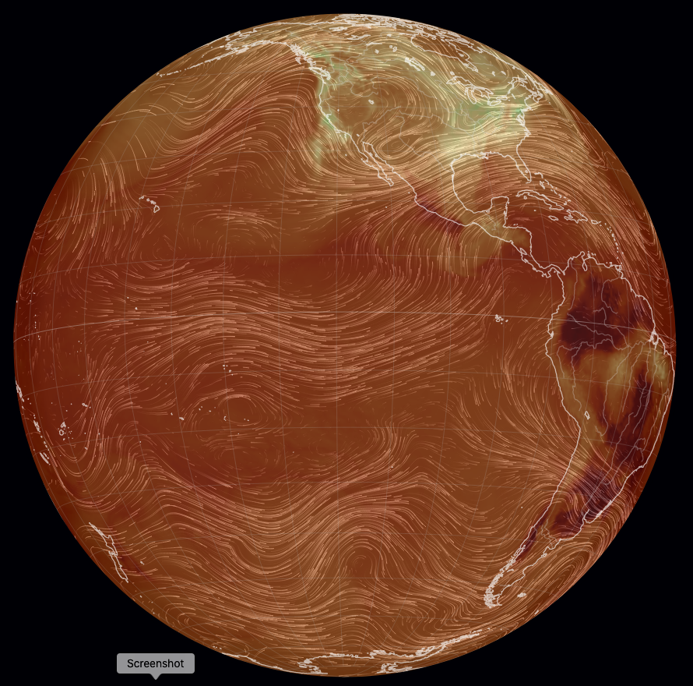
Utqiagvik, Alaska
Part II: Temperature and CO₂ over the last 800,000 years
Mauna Loa, Hawaii
Travelling south to Antarctica and back in time …
We will compare CO₂ temperature derived from ice cores from the Antarctic
These records date back to 800,000 years ago.
Antarctica
Carbon Dioxide Surface Concentration, from earth.nullschool.net on Dec. 4, 2020, 10:25 PT.

Slide 25
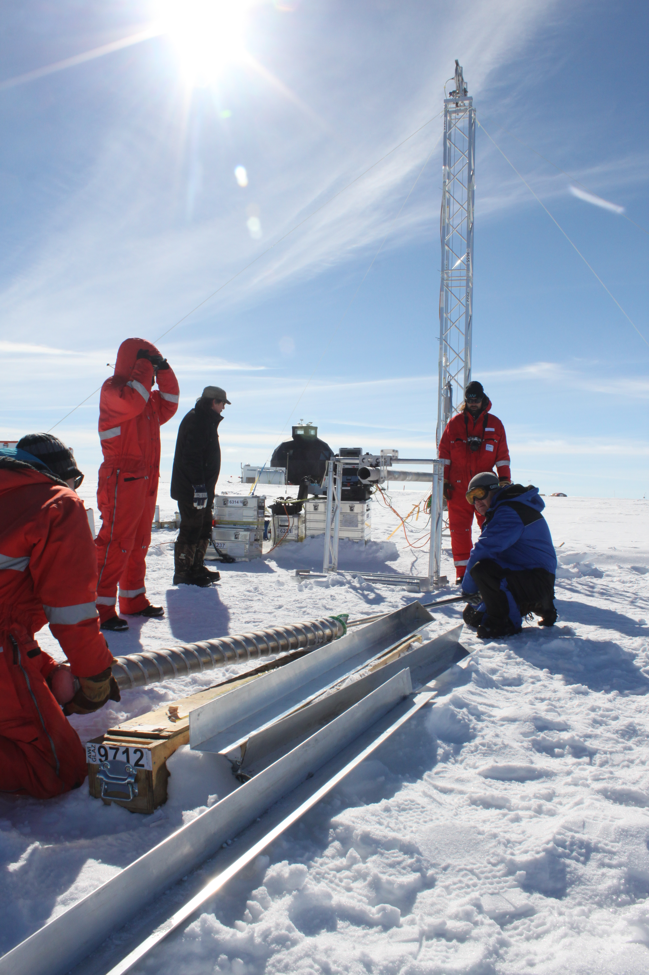
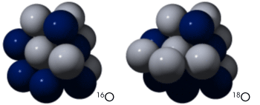
Isotopes in ice cores from polar regions tell the story of climate change on a Geological time scale
Courtesy Robert Simmon, NASA
Ice core researchers in Greenland. Photo by Helle Astrid Kjær / CC BY (https://creativecommons.org/licenses/by/4.0).
Notes:
The image at left shows Ice core researchers from AWI drilling at the EastGRIP ice core site Greenland

Slide 26
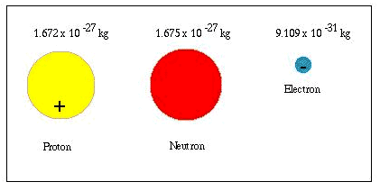
Parts Of An Atom
An atom is the smallest unit of matter that
retains the properties of an element
An electron is a subatomic particle with a single negative electrical charge and a mass about 1/2,000 that of a neutron or proton
A neutron is a subatomic particle that has no electrical charge and a mass of about 1.7 x 10⁻²⁴ g
A proton is a subatomic particle with a single positive electrical charge and a mass of about 1.7 x 10⁻²⁴ g
Courtesy Jet Propulsion Laboratory, Caltech, NASA
Notes:
For those of

Slide 27
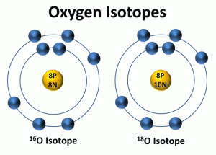
What Is An Isotope
An oxygen atom has 8 protons (+ charge) and 8 electrons (-1 charge). It also typically has 8 neutrons (no charge).
Isotopes of Oxygen have a different number of neutrons.
¹⁶O has 8 protons and 8 neutrons
¹⁸O has 8 protons and 10 neutrons
Water, or H₂O, has a mix of ¹⁶O and ¹⁸O.
Image courtesy Julie Lambart, Florida Atlantic University

Slide 28
Isotopes
The Oxyen in water (O in H₂O) is typically:
99.8% ¹⁶O
0.2% ¹⁸O
Extra ¹⁸O is called δ¹⁸O
δ¹⁸O = 0: normal water
δ¹⁸O > 0: heavier water
δ¹⁸O < 0: lighter water
Normal abundance is ~99.8%
Normal abundance is ~0.2%
Courtesy Robert Simmon, NASA

Slide 29
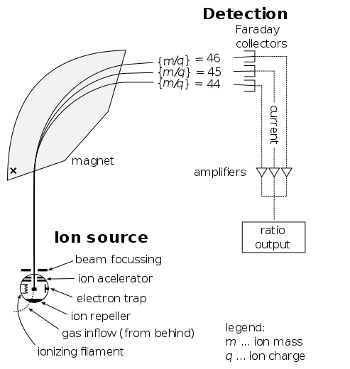
Mass spectrometers measure isotope composition very precisely
Schematic of a typical mass spectrometer
Courtesy of Devon Fyson

Slide 30
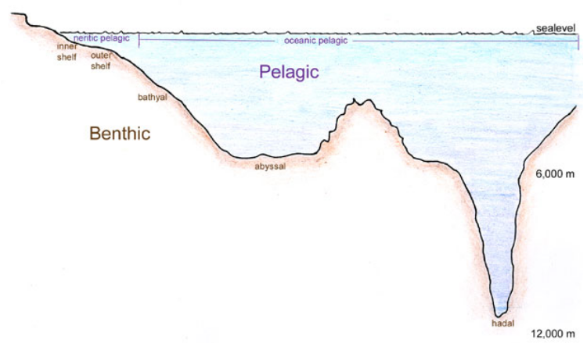
of water in the air and in the oceans
Water vapor in air above the oceans is a little ¹⁸O-depleted compared to normal (lighter)
Water left behind in the oceans is a little ¹⁸O-rich compared to normal (heavier)
Can you guess why?
Think about throwing a heavy ball into the air vs a light ball.
So, is δ¹⁸O in the air positive or negative?
Picture Courtesy of Genevieve Anderson

Slide 31
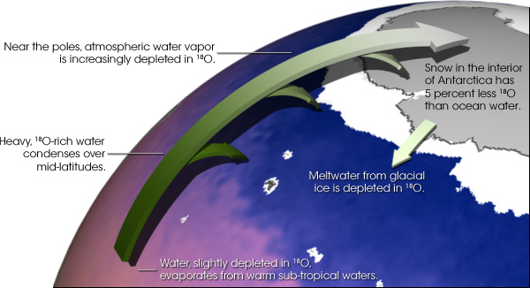
–depleted water in the air eventually falls as snow
¹⁸O in snow falling onto the Antarctic ice sheet is depleted compared to normal. The exact amount depends on where exactly you are in the Antarctic, but it ranges from 3 to 5%. A 3% depletion corresponds to δ¹⁸O = -30 ppt.
When the global temperatures are lower (like during an ice age), δ¹⁸O gets even more negative.
So, oxygen isotopes in ice cores act like a kind of thermometer.
Courtesy Robert Simmon, NASA

Slide 32
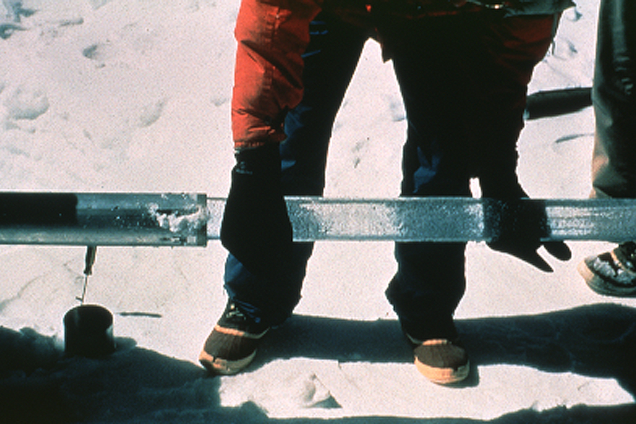
as a thermometer of past climates
Courtesy
Lonnie Thompson

Slide 33
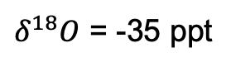
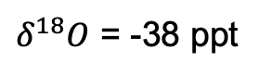
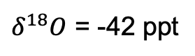
as a thermometer of past climates
Surface
$δ^{18}O$ = -35 ppt
Which is the oldest sample?
At which time (depth) was the climate coldest?
1000 meters deep
$δ^{18}O$ = -42 ppt
2000 meters deep
$δ^{18}O$ = -38 ppt

Slide 34
as a thermometer of past climates
Surface
$δ^{18}O$ = -35 ppt
Which is the oldest sample?
At which time (depth) was the climate coldest? Hint: lower global temperatures => δ¹⁸O gets even more negative.
1000 meters deep
$δ^{18}O$ = -42 ppt
2000 meters deep
$δ^{18}O$ = -38 ppt

Slide 35
Image source: Lucian Dachman, Unsplash

Slide 36
References
Part Of An Atom: NASA, https://genesismission.jpl.nasa.gov/gm2/science/atoms.htm
What Is An Isotope: Lambart, Julie, FAU, http://www.ces.fau.edu/nasa/module-3/how-is-temperature-measured/isotopes.php
Isotopes: Simmon, Robert, NASA, https://earthobservatory.nasa.gov/features/Paleoclimatology_OxygenBalance
Mass Spectrometer: Fyson, Devon, https://commons.wikimedia.org/wiki/File:Mass_Spectrometer_Schematic.svg
Ocean profile: Anderson, Genevieve, SBCC, https://www.marinebio.net/marinescience/01intro/woclass.htm
18O map: Simmon, Robert, NASA, https://earthobservatory.nasa.gov/features/Paleoclimatology_OxygenBalance
Ice core: Thompson, Lonnie, http://www.antarcticglaciers.org/glaciers-and-climate/ice-cores/ice-core-basics/#jp-carousel-5901
100 kyr timeline: Steffen, Will. Notes: (i) the estimates of human migration patterns (dates etc.) come from a wide variety of sources on human migration out of Africa, and (ii) the actual timeline of temperature changes comes from the GRIP (Greenland) ice core, as published in: Ganopolski A and Rahmstorf S (2001) Rapid changes of glacial climate simulated in a coupled climate model. Nature 409: 153-158.
North American and Eurasian ice sheets: Patton, H., Hubbard, A., Andreassen, K., Winsborrow, M., Stroeven, A.P., 2016. The build-up, configuration, and dynamical sensitivity of the Eurasian ice-sheet complex to Late Weichselian climatic and oceanic forcing. Quaternary Science Reviews 153, 97–121. https://doi.org/10.1016/j.quascirev.2016.10.009
Greenland: NASA Visualization, https://www.astrobio.net/also-in-news/greenland-ice-sheet-vulnerable-climate-change-previously-thought/
Antarctica: Eales, Philip, Planetary Visions, https://climate.nasa.gov/news/2749/ramp-up-in-antarctic-ice-loss-speeds-sea-level-rise/
Corell, Robert, http://www.climatecodered.org/2011/01/rethinking-safe-climate-have-we-already.html
Larsen B: NASA, https://www.livescience.com/42562-antarctic-ice-shelf-collapse-cause.html
Sea Level Equivalents: Davies, Bethan, 2019, http://www.antarcticglaciers.org/glaciers-and-climate/what-is-the-global-volume-of-land-ice-and-how-is-it-changing/
Mountain Glaciers: NASA, https://www.nasa.gov/feature/goddard/2019/a-decade-of-icebridge-alaska-flights
Milankovitch cycles, UCAR, https://www.universetoday.com/39012/milankovitch-cycle/

Slide 37


Acknowledgements
This Polar ENgagement through GUided INquiry (PENGUIN) module was created with funding from the National Science Foundation. Creative Commons Copyright.
You may freely use and share with attribution to the PENGUIN project as follows:
Rowe, P.M. et al (2020): Integrating polar research into undergraduate curricula using computational guided inquiry, Journal of Geoscience Education, https://doi.org/10.1080/10899995.2020.1768004.

Slide 38
Check out other PENGUIN modules
Processing Images of Arctic Ice: Explore image processing of polar satellite images.
Ice Cores and Climate Change: Work with data from ice cores from the East Antarctic Ice Sheet and Greenland, to explore earth's past climate and glacial cycles.
Heat flux through Permafrost: Learn what permafrost is and how it is impacted by climate change, and calculate heat flux through permafrost.
Polar spectra and Quantum Mechanics: Learn about the greenhouse effect by examining infrared emission spectra of the polar atmosphere.
Thermodynamics of Arctic Ice melt: Explore Arctic sea ice extent and calculate the amount of heat required to melt Arctic sea ice

Slide 39
Background:
Climate Change
Climate changes naturally (but slowly)
Humans are changing climate change rapidly through emitting fossil fuels like CO₂
Carbon Dioxide Surface Concentration, from earth.nullschool.net on Dec. 4, 2020, 09:31 PT.
Image source: Lucian Dachman, Unsplash

Slide 40
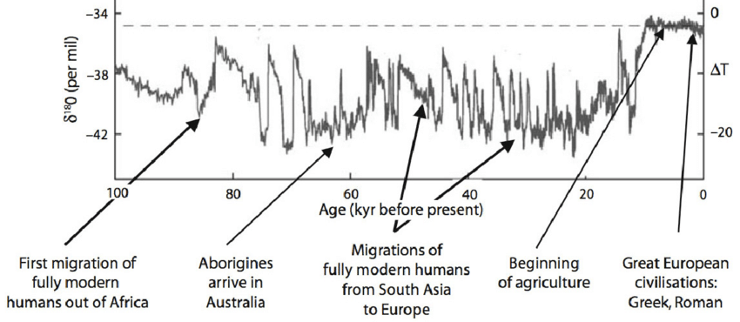
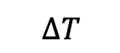
Natural Climate Change over the last 100,000 years
$$∆T$$
1 kyr = 1000 years
Can you identify important human events around these times?
Notes:
https://www.researchgate.net/publication/280316525_Chapter_20_Extreme_weather_and_resilience_of_the_global_food_system/figures?lo=1

Slide 41
Natural Climate Change over the last 100,000 years
Notes:
https://www.researchgate.net/publication/280316525_Chapter_20_Extreme_weather_and_resilience_of_the_global_food_system/figures?lo=1

Slide 42
Natural Climate Change over the last 100,000 years
Notes:
https://www.researchgate.net/publication/280316525_Chapter_20_Extreme_weather_and_resilience_of_the_global_food_system/figures?lo=1

Slide 43
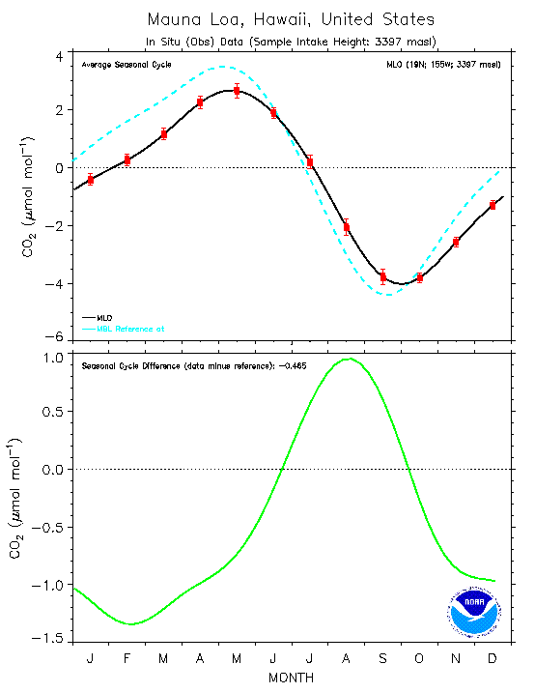
Seasonal CO2 Cycle at Mauna Loa
Black line: average seasonal cycle determined from the observations (monthly mean aggregated)
Red box: Standard Error of each aggregated monthly mean value
Blue line: average seasonal cycle based on the reference Marine Boundary Layer (MLB) time series at same latitude
Green line: difference between the average seasonal cycle derived from the Mauna Loa data vs. the MLB reference
Source: ESRL Global Monitoring Laboratory

Slide 44
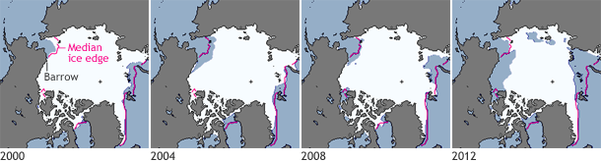
Climate Change: Receding Sea Ice Extent in Utqiagvik, AK
P
Figure shows receding sea ice extent from 2000 to 2012
Pink line: October median ice extent (median: middle value in a range of numbers)
White shows areas with at least 15% ice cover
Data from National Snow and Ice Data Center

Slide 45
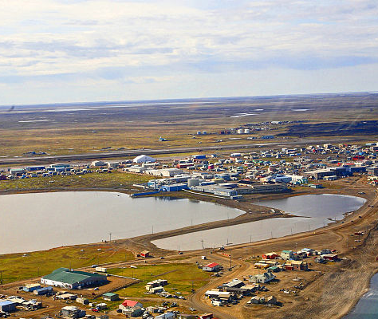
Utqiagvik, Alaska:
Formerly known as Barrow , Alaska
Located in the Arctic Circle (polar)
Home to the Inupiat (an indigenous Inuit ethnic group) for more than 1,500 years
Source: unknown author, Wikimedia

